Slide 1
Software Engineering I
Dr. Elham Mahmoudzadeh
Isfahan University of Technology
mahmoudzadeh@iut.ac.ir
2024

Slide 2
Chapter 4 Functional Modeling(III)

Slide 3
Steps(I)
Preparing proposal
Requirements determination
User story
Abstract Business Process Modelling
Analysis
Functional Modelling
Structural Modelling
Behavioral Modelling

Slide 4
Steps(II)
Design
Optimization
Database Management
User Interface
Physical Architecture

Slide 5
Introduction
Use-case diagrams provided a bird’s-eye view of the basic functionality of the business processes contained in the evolving system.
Activity diagrams, in a sense, open up the black box of each business process by providing a more-detailed graphical view of the underlying activities that support each business process.
Use-case descriptions provide a means to more fully document the different aspects of each individual use case.

Slide 6
The use-case descriptions are based on the identified requirements, use-case diagram, and the activity diagram of the business processes.
Use-case descriptions contain all the information needed to document the functionality of the business processes.

Slide 7
Introduction
Use cases are the primary drivers for all the UML diagramming techniques.
A use case communicates at a high level what the system needs to do, and all the UML diagramming techniques build on this by presenting the use-case functionality in a different way for a different purpose.
Use cases are the building blocks by which the system is designed and built.

Slide 8
Introduction
Use cases capture the typical interaction of the system with the system’s users (end users and other systems).
These interactions represent the external, or functional view of the system from the perspective of the user.
Each use case describes one and only one function in which users interact with the system.
Although a use case may contain several paths that a user can take while interacting with the system, each possible execution path through the use case is referred to as a scenario.

Slide 9
Introduction
When creating use-case descriptions, the project team must work closely with the users to fully document the functional requirements.
Organizing the functional requirements and documenting them in a use-case description are a relatively simple process, but it takes considerable practice to ensure that the descriptions are complete enough to use in structural and behavioral modeling.
The best place to begin is to review the use-case and activity diagrams.
It is possible that multiple users will play the same role. Therefore, use cases should be associated with the roles played by the users and not with the users themselves.

Slide 10
Types of Use Cases
Classify a use case based on the purpose of the use case and the amount of information that the use case contains: overview versus detail and essential versus real.

Slide 11
Overview use case vs. detail use case
Over view use case is used to enable the analyst and user to agree on a high-level overview of the requirements.
Typically, overview use cases are created very early in the process of understanding the system requirements, and they document only basic information about the use case.
These can easily be created immediately after the creation of the use-case diagram.
A detail use case typically documents, as far as possible, all the information needed for the use case.
These can be based on the activities and control flows contained in the activity diagrams.

Slide 12
Essential use case vs. real use case
An essential use case is one that describes only the minimum essential issues necessary to understand the required functionality.
A real use case goes farther and describes a specific set of steps.
The primary difference is that essential use cases are implementation independent, whereas real use cases are detailed descriptions of how to use the system once it is implemented.
Thus, real use cases tend to be used only in the design, implementation, and testing.

Slide 13
Elements of a Use-Case Description
A use-case description contains all the information needed to build the structural and behavioral diagrams that follow, but it expresses the information in a less-formal way that is usually simpler for users to understand.
A use-case description has three basic parts: overview information, relationships, and the flow of events.

Slide 14
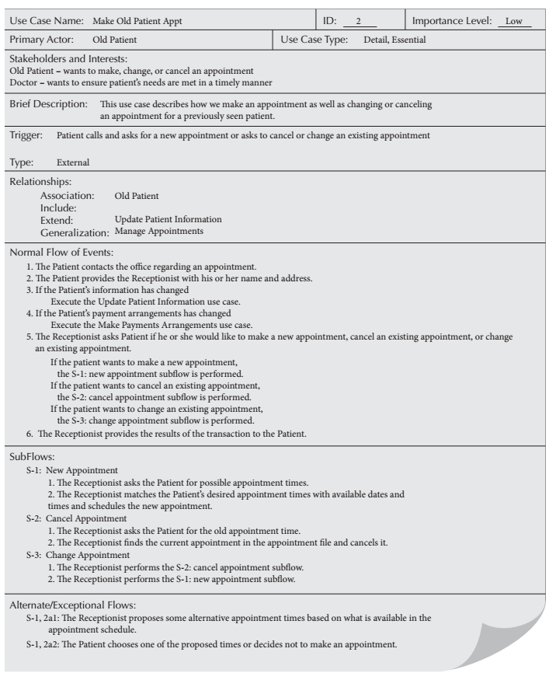
overview
Relationships
Flow of events

Slide 15
Overview Information
Identifies the use case and provides basic background information.
The use-case name should be a verb–noun.
The use-case ID number provides a unique way to find every use case and also enables the team to trace design decisions back to a specific requirement.
The use-case type is either overview or detail and essential or real.
The primary actor is usually the trigger of the use case—the person or thing that starts the execution of the use case. The primary purpose of the use case is to meet the goal of the primary actor.
The brief description is typically a single sentence that describes the essence of the use case.

Slide 16
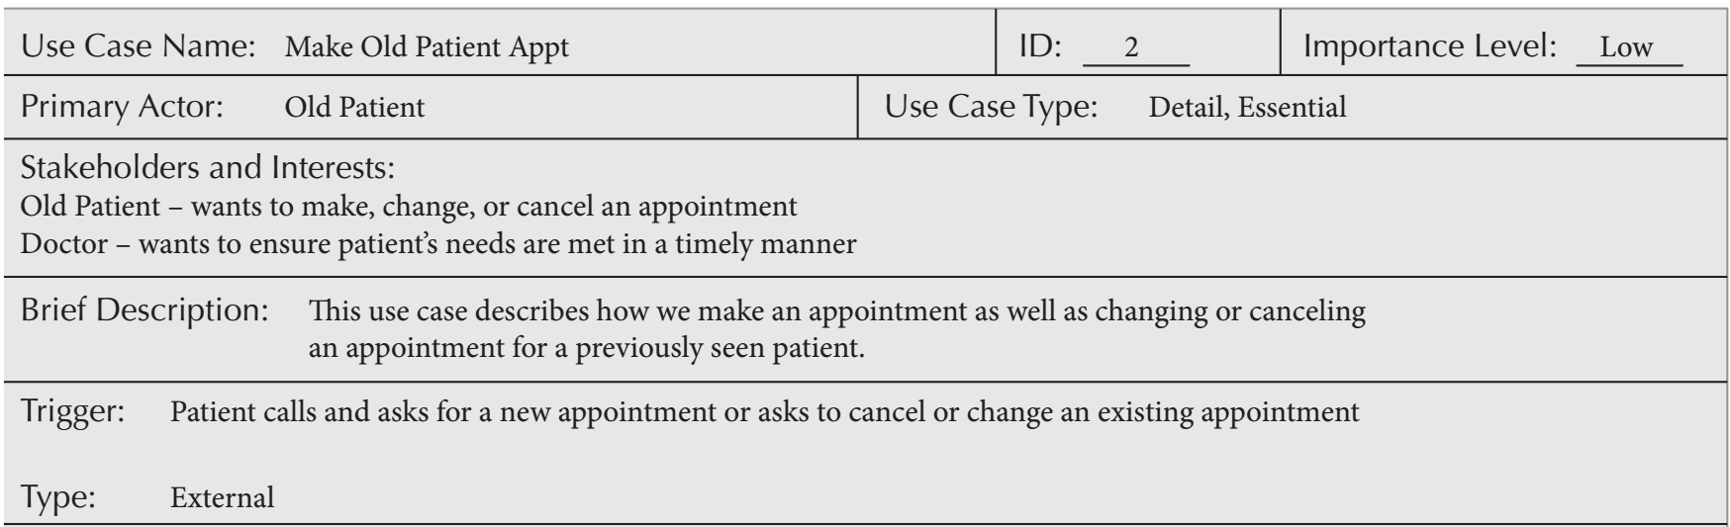

Slide 17
Overview Information(Cnt’d)
The importance level can be used to prioritize the use cases. The importance level enables the users to explicitly prioritize which business functions are most important and need to be part of the first version of the system and which are less important and can wait until later versions if necessary. The importance level can use a fuzzy scale, such as high, medium, and low. It can also be done more formally using a weighted average of a set of criteria.

Slide 19
Overview Information(Cnt’d)
A use case may have multiple stakeholders that have an interest in the use case. Each use case lists each of the stakeholders with each one’s interest in the use case. The stakeholders’ list always includes the primary actor.
Each use case typically has a trigger—the event that causes the use case to begin. A trigger can be an external trigger, such as a customer placing an order or the fire alarm ringing, or it can be a internal trigger.

Slide 21
Relationships
Use-case relationships explain how the use case is related to other use cases and users.
There are four basic types of relationships: association, extend, include, and generalization.
An association relationship documents the communication that takes place between the use case and the actors that use the use case.
An include relationship represents the mandatory inclusion of another use case. The include relationship enables functional decomposition—the breaking up of a complex use case into several simpler ones. The include relationship also enables parts of use cases to be reused by creating them as separate use cases.

Slide 22
Relationships(Cnt’d)
An extend relationship represents the extension of the functionality of the use case to incorporate optional behavior.
The generalization relationship allows use cases to support inheritance.

Slide 23
Flow of Events
Finally, the individual steps within the business process are described. Three different categories of steps, or flows of events, can be documented: normal flow of events, sub flows, and exceptional flows.

Slide 24
Normal flow of events
Includes only steps that normally are executed in a use case. The steps are listed in the order in which they are performed.
In some cases, the normal flow of events should be decomposed into a set of sub flows to keep the normal flow of events as simple as possible.
Alternatively, we could replace a sub flow with a separate use case that could be incorporated via the include relationships. If it does, then the specific sub flow(s) should be replaced with a call to the related use case, and the use case should be added to the include relationship list.

Slide 25
Alternative or exceptional flows
Are ones that do happen but are not considered to be the norm. These must be documented.
Like the sub flows, the primary purpose of separating out alternate or exceptional flows is to keep the normal flow of events as simple as possible.

Slide 26
When should events be factored out
from the normal flow of events into sub flows?
When should sub flows and/or exceptional flows be factored out
into separate use cases?

Slide 27
The answer
The primary criteria should be based on the level of complexity that the use case entails. The more difficult it is to understand the use case, the more likely events should be factored out into sub flows, or sub flows and/or alternative or exceptional flows should be factored out into separate use cases that are called by the current use case. This, creates more use cases.
We are trying to represent, in a manner as complete and concise as possible, our understanding of the business processes that we are investigating so that the client can validate the requirements that we are modeling.

Slide 28
Optional Characteristics
Other characteristics of use cases can be documented by use-case descriptions.
Level of complexity of the use case;
The estimated amount of time it takes to execute the use case;
The system with which the use case is associated;
Specific data flows between the primary actor and the use case;
Any specific attribute, constraint, or operation associated with the use case;
Any preconditions that must be satisfied for the use case to execute;
Any guarantees that can be made based on the execution of the use case.
There is no standard set of characteristics of a use case that must be captured.

Slide 29
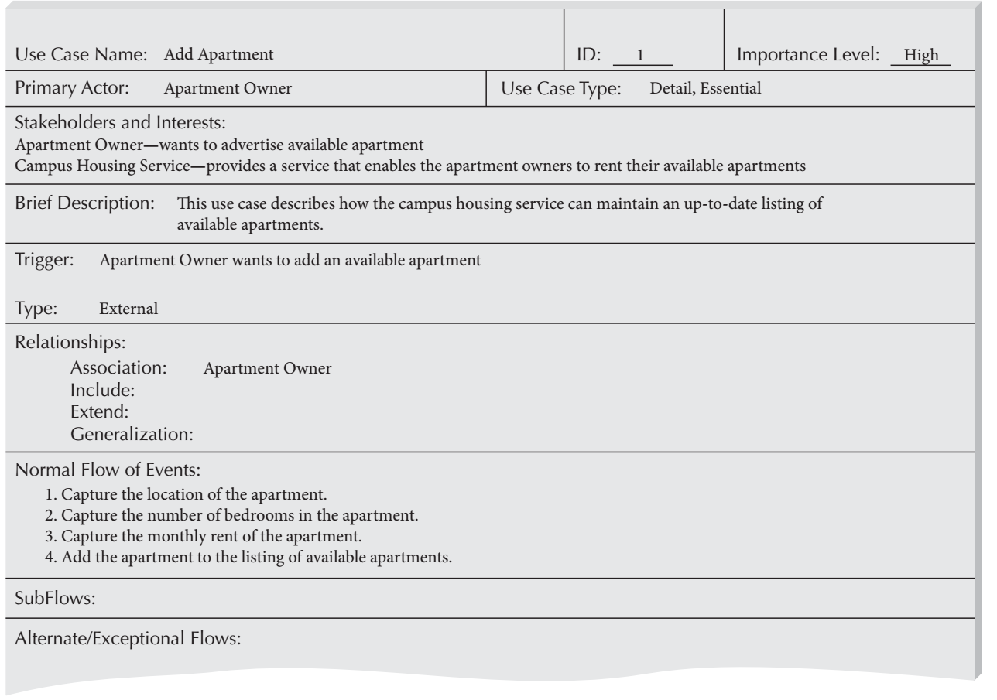
Campus Housing Service Add an Apartment Use-Case Description

Slide 30
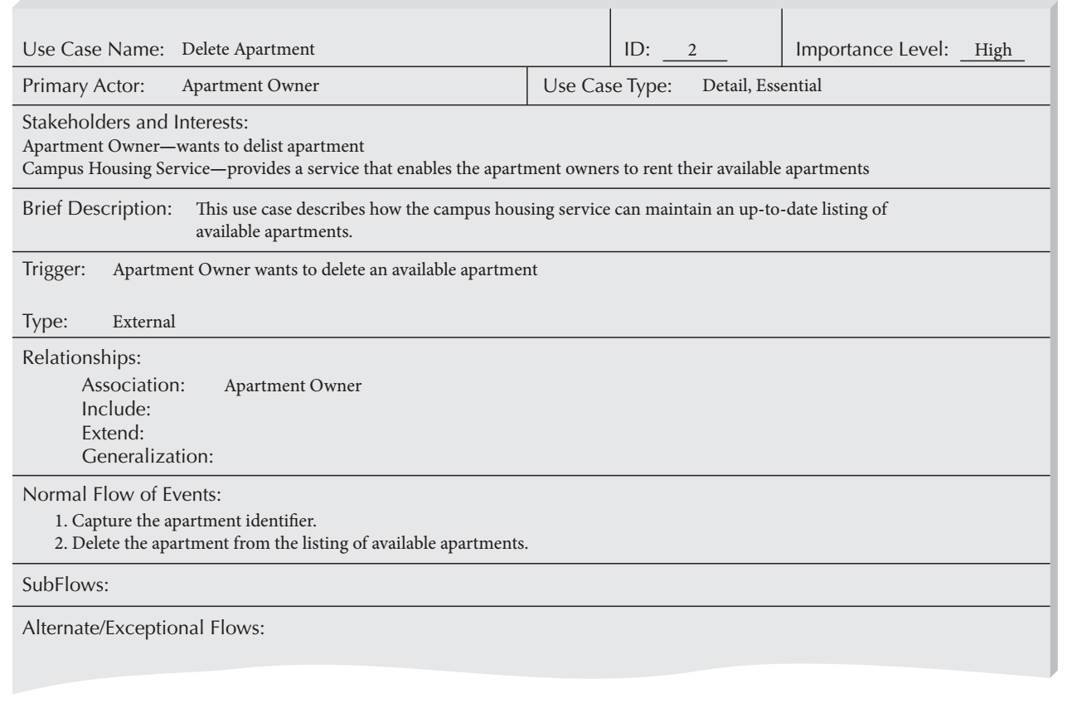
Campus Housing Service Delete an Apartment Use-Case Description

Slide 31
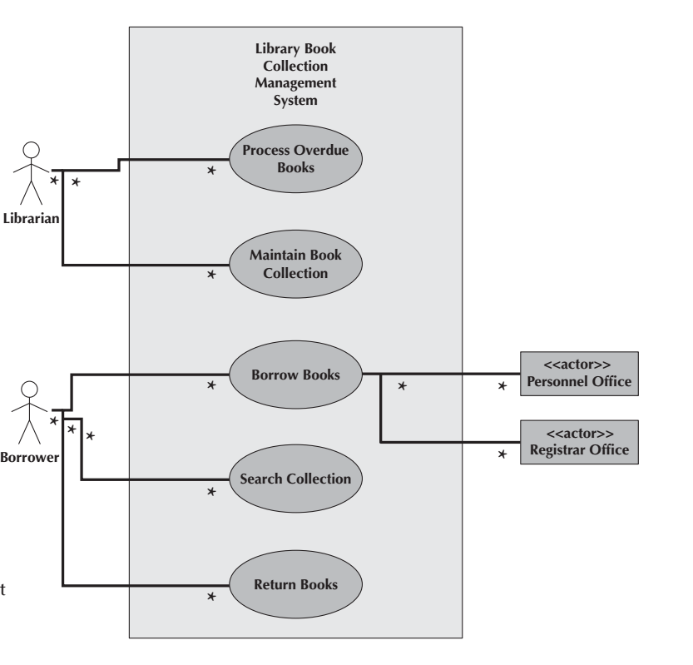

Slide 32
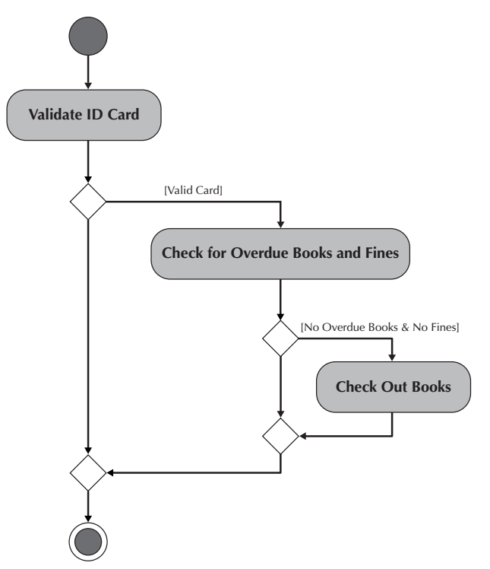

Slide 33
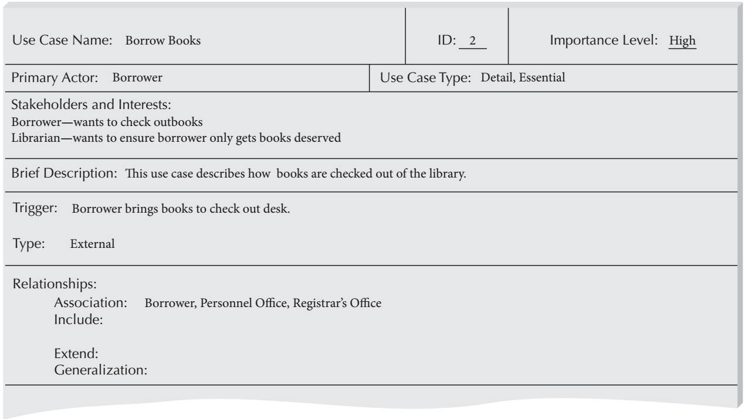
Overview Description for the Borrow Books Use Case

Slide 34
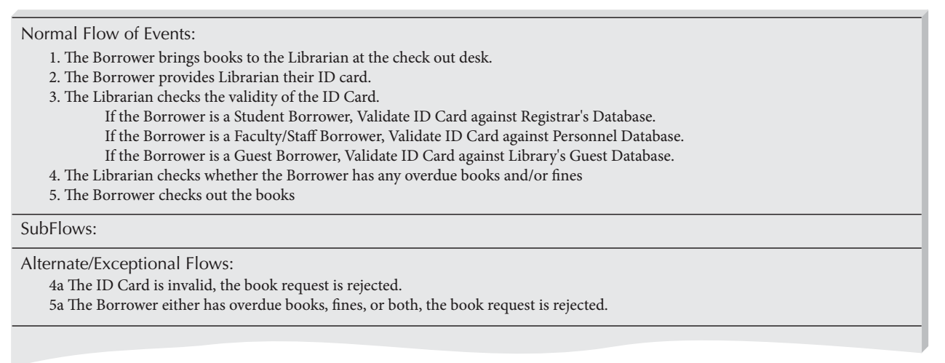
Flow Descriptions for the Borrow Books Use Case

Slide 35
What should you do for your project?
Write use case description for each use case.
We will work in the lab.

Slide 36
Reference
Dennis, Wixon, Tegarden, “System Analysis and Design, An Object Oriented Approach with UML”, 5th Edition, 2015.

